Slide 1
Design of Test Benches Using VHDL

Slide 2
Testbench Defined
Testbench = VHDL entity that applies stimuli (drives the inputs) to the Design Under Test (DUT) and (optionally) verifies expected outputs.
The results can be viewed in a waveform window or written to a file.
Since Testbench is written in VHDL, it is not restricted to a single simulation tool (portability).
The same Testbench can be easily adapted to test different implementations (i.e. different architectures) of the same design.

Slide 3
Simple Testbench
Processes
Generating
Stimuli
Design Under Test (DUT)
Observed Outputs
Notes:
Verify simulated outputs with expected output to see if the design behaves according to specification

Slide 4
Possible sources of expected results used for comparison
Testbench
actual results
VHDL Design
= ?
Representative
Inputs
Manual Calculations
or
Reference Software Implementation
(C, Java, Matlab )
expected results

Slide 5
Testbench
The same testbench can be used to
test multiple implementations of the same circuit
(multiple architectures)
testbench
design entity
Architecture 1
Architecture 2
. . . .
Architecture N

Slide 6
Testbench Anatomy
ENTITY my_entity_tb IS
--TB entity has no ports
END my_entity_tb;
ARCHITECTURE behavioral OF tb IS
--Local signals and constants
COMPONENT TestComp --All Design Under Test component declarations
PORT ( );
END COMPONENT;
-----------------------------------------------------
BEGIN
DUT:TestComp PORT MAP( -- Instantiations of DUTs
);
testSequence: PROCESS
-- Input stimuli
END PROCESS;
END behavioral;
Notes:
Internal signals are from DUT.
Main process may be split into main process. I.e. one to drive clk, rst and other for test vectors.
Many architectures can be tested by inserting more
for DUT:TestComp use entity work.TestComp(archName) statmetns
“work” is the name of the library that “TestComp” is being compiled to.
The “DUT” tag is required.

Slide 7
Testbench for XOR3 (1)
LIBRARY ieee;
USE ieee.std_logic_1164.all;
ENTITY xor3_tb IS
END xor3_tb;
ARCHITECTURE behavioral OF xor3_tb IS
-- Component declaration of the tested unit
COMPONENT xor3
PORT(
A : IN STD_LOGIC;
B : IN STD_LOGIC;
C : IN STD_LOGIC;
Result : OUT STD_LOGIC );
END COMPONENT;
-- Stimulus signals - signals mapped to the input and inout ports of tested entity
SIGNAL test_vector: STD_LOGIC_VECTOR(2 DOWNTO 0);
SIGNAL test_result : STD_LOGIC;

Slide 8
Testbench for XOR3 (2)
BEGIN
UUT : xor3
PORT MAP (
A => test_vector(2),
B => test_vector(1),
C => test_vector(0),
Result => test_result);
);
Testing: PROCESS
BEGIN
test_vector <= "000";
WAIT FOR 10 ns;
test_vector <= "001";
WAIT FOR 10 ns;
test_vector <= "010";
WAIT FOR 10 ns;
test_vector <= "011";
WAIT FOR 10 ns;
test_vector <= "100";
WAIT FOR 10 ns;
test_vector <= "101";
WAIT FOR 10 ns;
test_vector <= "110";
WAIT FOR 10 ns;
test_vector <= "111";
WAIT FOR 10 ns;
END PROCESS;
END behavioral;

Slide 9
VHDL Design Styles
VHDL Design
Styles
dataflow
structural
behavioral
Concurrent
statements
Components and
interconnects
Sequential statements
Testbenches

Slide 10

Process without Sensitivity List
and its use in Testbenches
ECE 448 – FPGA and ASIC Design with VHDL

Slide 11
What is a PROCESS?
  A process is a sequence of instructions referred to as sequential statements.
The keyword PROCESS
A process can be given a unique name using an optional LABEL
This is followed by the keyword PROCESS
The keyword BEGIN is used to indicate the start of the process
All statements within the process are executed SEQUENTIALLY. Hence, order of statements is important.
A process must end with the keywords END PROCESS.
Testing: PROCESS
BEGIN
test_vector<=“00”;
WAIT FOR 10 ns;
test_vector<=“01”;
WAIT FOR 10 ns;
test_vector<=“10”;
WAIT FOR 10 ns;
test_vector<=“11”;
WAIT FOR 10 ns;
END PROCESS;

Slide 12
Execution of statements in a PROCESS
Testing: PROCESS
BEGIN
test_vector<=“00”;
WAIT FOR 10 ns;
test_vector<=“01”;
WAIT FOR 10 ns;
test_vector<=“10”;
WAIT FOR 10 ns;
test_vector<=“11”;
WAIT FOR 10 ns;
END PROCESS;
The execution of statements continues sequentially till the last statement in the process.
After execution of the last statement, the control is again passed to the beginning of the process.
Order of execution
Program control is passed to the first statement after BEGIN

Slide 13
PROCESS with a WAIT Statement
The last statement in the PROCESS is a WAIT instead of WAIT FOR 10 ns.
This will cause the PROCESS to suspend indefinitely when the WAIT statement is executed.
This form of WAIT can be used in a process included in a testbench when all possible combinations of inputs have been tested or a non-periodical signal has to be generated.
Testing: PROCESS
BEGIN
test_vector<=“00”;
WAIT FOR 10 ns;
test_vector<=“01”;
WAIT FOR 10 ns;
test_vector<=“10”;
WAIT FOR 10 ns;
test_vector<=“11”;
WAIT;
END PROCESS;
Order of execution
Program execution stops here

Slide 14

WAIT FOR vs. WAIT
WAIT FOR: waveform will keep repeating itself forever
…
0
1
2
3
0
1
2
3
WAIT : waveform will keep its state after the last wait instruction.
…

Slide 15
Specifying time in VHDL
ECE 448 – FPGA and ASIC Design with VHDL

Slide 16
Time values (physical literals) - Examples
unit of time
most commonly
used in simulation
7 ns
1 min
min
10.65 us
10.65 fs
Numeric value
Space
(required)
Unit of time

Slide 17
Units of time
Unit Definition
Base Unit
fs femtoseconds (10⁻¹⁵ seconds)
Derived Units
ps picoseconds (10⁻¹² seconds)
ns nanoseconds (10⁻⁹ seconds)
us microseconds (10⁻⁶ seconds)
ms miliseconds (10⁻³ seconds)
sec seconds
min minutes (60 seconds)
hr hours (3600 seconds)

Slide 18
Simple Testbenches
ECE 448 – FPGA and ASIC Design with VHDL

Slide 19
Generating selected values of one input
SIGNAL test_vector : STD_LOGIC_VECTOR(2 downto 0);
BEGIN
......
      testing: PROCESS
      BEGIN
      test_vector <= "000";
      WAIT FOR 10 ns;
      test_vector <= "001";
      WAIT FOR 10 ns;
      test_vector <= "010";
      WAIT FOR 10 ns;
      test_vector <= "011";
      WAIT FOR 10 ns;
      test_vector <= "100";
      WAIT FOR 10 ns;
      END PROCESS;
....END behavioral;

Slide 20
Generating all values of one input
SIGNAL test_vector : STD_LOGIC_VECTOR(3 downto 0):="0000";
BEGIN
.......
testing: PROCESS
BEGIN
WAIT FOR 10 ns;
test_vector <= test_vector + 1;
end process TESTING;
........
END behavioral;

Slide 21
Arithmetic Operators in VHDL (1)
To use basic arithmetic operations involving
std_logic_vectors you need to include the
following library packages:
LIBRARY ieee;
USE ieee.std_logic_1164.all;
USE ieee.std_logic_unsigned.all;
USE ieee.std_logic_arith.all;
Notes:
Internal signals are from DUT.
Main process may be split into main process. I.e. one to drive clk, rst and other for test vectors.
Many architectures can be tested by inserting more
for DUT:TestComp use entity work.TestComp(archName) statmetns
“work” is the name of the library that “TestComp” is being compiled to.
The “DUT” tag is required.

Slide 22
Arithmetic Operators in VHDL (2)
You can use standard +, - operators
to perform addition and subtraction:
signal A : STD_LOGIC_VECTOR(3 downto 0);
signal B : STD_LOGIC_VECTOR(3 downto 0);
signal C : STD_LOGIC_VECTOR(3 downto 0);
……
C <= A + B;
Notes:
Internal signals are from DUT.
Main process may be split into main process. I.e. one to drive clk, rst and other for test vectors.
Many architectures can be tested by inserting more
for DUT:TestComp use entity work.TestComp(archName) statmetns
“work” is the name of the library that “TestComp” is being compiled to.
The “DUT” tag is required.

Slide 23
Different ways of performing the same operation
signal count: std_logic_vector(7 downto 0);
You can use:
count <= count + “00000001”;
or
count <= count + 1;
or
count <= count + ‘1’;

Slide 24
Generating all possible values of two inputs
SIGNAL test_ab : STD_LOGIC_VECTOR(1 downto 0);
SIGNAL test_sel : STD_LOGIC_VECTOR(1 downto 0);
BEGIN
.......
    double_loop: PROCESS
    BEGIN
    test_ab <="00";
    test_sel <="00";
    for I in 0 to 3 loop
    for J in 0 to 3 loop
    wait for 10 ns;
    test_ab <= test_ab + 1;
    end loop;
    test_sel <= test_sel + 1;
    end loop;
    END PROCESS;
........
END behavioral;

Slide 25
Generating periodical signals, such as clocks
CONSTANT clk1_period : TIME := 20 ns;
CONSTANT clk2_period : TIME := 200 ns;
SIGNAL clk1 : STD_LOGIC;
SIGNAL clk2 : STD_LOGIC := ‘0’;
BEGIN
.......
clk1_generator: PROCESS
clk1 <= ‘0’;
WAIT FOR clk1_period/2;
clk1 <= ‘1’;
WAIT FOR clk1_period/2;
END PROCESS;
clk2 <= not clk2 after clk2_period/2;
.......
END behavioral;

Slide 26
Generating one-time signals, such as resets
CONSTANT reset1_width : TIME := 100 ns;
CONSTANT reset2_width : TIME := 150 ns;
SIGNAL reset1 : STD_LOGIC;
SIGNAL reset2 : STD_LOGIC := ‘1’;
BEGIN
.......
reset1_generator: PROCESS
reset1 <= ‘1’;
WAIT FOR reset_width;
reset1 <= ‘0’;
WAIT;
END PROCESS;
reset2_generator: PROCESS
WAIT FOR reset_width;
reset2 <= ‘0’;
WAIT;
END PROCESS;
.......
END behavioral;

Slide 27
Write the Test Bench for 4-to-1 Multiplexer
s
0
s
1
s
1
s
0
f
w
0
00
0
0
w
0
w
1
01
f
0
1
w
1
w
2
10
1
0
w
w
3
11
w
2
1
1
3
(a) Graphic symbol
(b) Truth table
s
0
w
0
s
1
w
1
f
w
2
w
3
(c) Circuit

Slide 28
Write the Test Bench for Full adder
x
sum
y
Full Adder
cout
cin

Slide 29
Write the Test Bench for 2-to-4 Decoder
En
w
1
w
0
y
3
y
2
y
1
y
0
w
1
y
3
1
0
0
0
0
0
1
w
y
1
0
1
0
0
1
0
0
2
1
1
0
0
1
0
0
y
1
1
1
1
1
0
0
0
En
y
0
0
-
-
0
0
0
0
(a) Truth table
(b) Graphical symbol
w
0
y
0
w
1
y
1
y
2
y
3
En
(c) Logic circuit

Slide 30
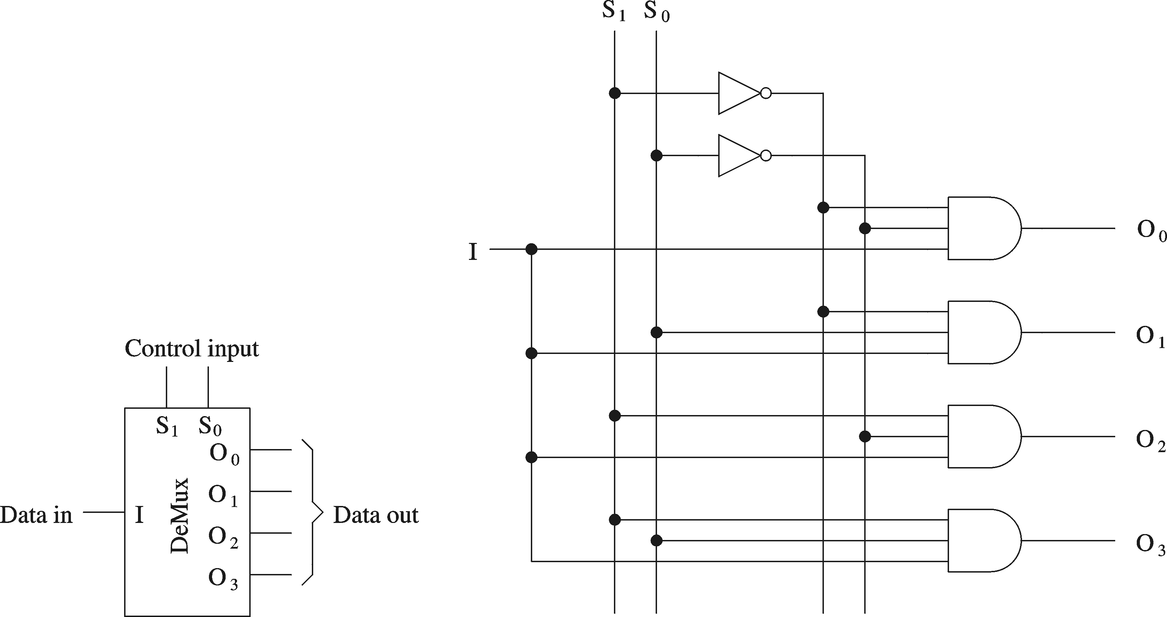
Write the Test Bench for 1-to-4 Demultiplexer

Slide 31
Write the Test Bench for Counter with clock selector
reset
Clk0
Clk1
mux
counter
count
Clk2
Clk3
cs1
cs0

Slide 32
Write the Test Bench for Circuit built of medium scale components
s(0)
r(0)
p(0)
En
0
r(1)
1
w
q(0)
Enable
p(1)
0
y
w
y
0
0
0
z(0)
t(0)
r(2)
w
q(1)
p(2)
1
y
w
y
1
1
1
r(3)
w
z(1)
t(1)
2
ena
D
Q
z
y
w
2
3
z(2)
t(2)
r(4)
p(3)
priority
y
0
En
3
z(3)
t(3)
dec2to4
regn
r(5)
1
Clk
Clock
s(1)

